Slide 2

Machine Learning
What is Machine Learning: When you think about Machine Learning (ML) what comes to mind. This ?

Slide 3
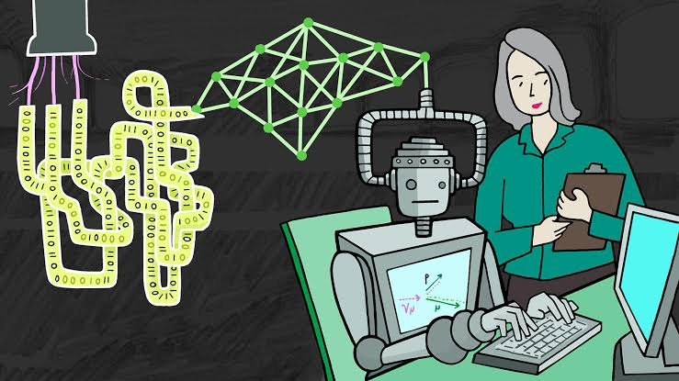
Or this:

Slide 4
Machine learning research is part of research on artificial intelligence, seeking to provide knowledge to computers through data, observations and interacting with the world. That acquired knowledge allows computers to correctly generalize to new settings. - Dr. Yoshua Bengio
“Machine Learning at its most basic is the practice of using algorithms to parse data, learn from it, and then make a determination or prediction about something in the world.” – Nvidia
Simply put, Machine Learning are mathematical algorithm which end goal is to learn from data and make prediction about similar instance in a new data point.

Slide 5
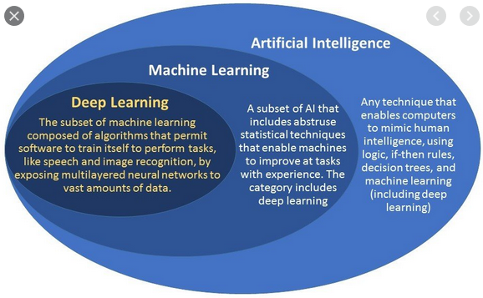
Difference between Machine learning, Artificial intelligence and Deep Learning
Artificial intelligence is imparting a cognitive ability to a machine. It is basically giving machine a form of intelligent.

Slide 6
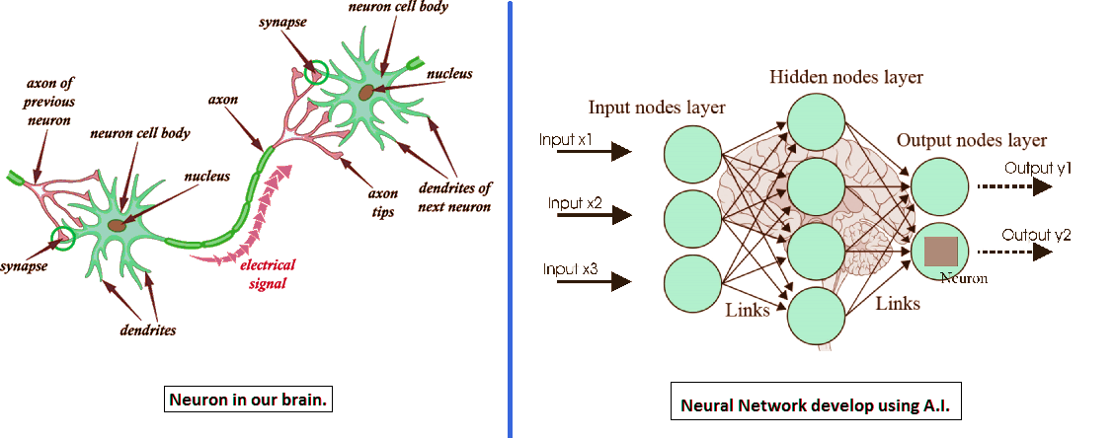
Deep Learning is a computer algorithm that simulates the network of neurons in a brain. It is a subset of Machine Learning.

Slide 7
Concept to Note Going Forward: These are some basic concept which must be defined before moving forward
Feature: These are groups of data points which would be used to train the classifier they are sometimes called the independent variable.
Label/ Target: This is the dependent variable or what the model is trying to predict. e.g (whether the animal is a Dog or cat)
Classifier: A classifier uses the features of an object to try identifying the class it belongs to (Machine Learning Model)

Slide 8
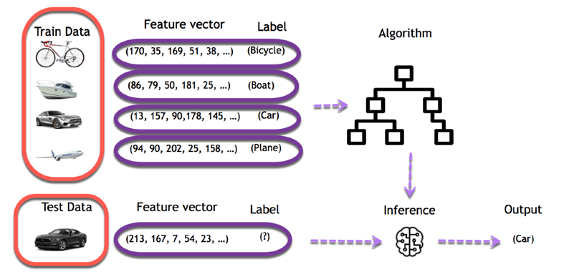

Slide 9
Key Elements of Machine Learning :There are tens of thousands of machine learning algorithms and hundreds of new algorithms are developed every year. Every machine learning algorithm has three components:
Representation: how to represent knowledge. Examples include decision trees, sets of rules, instances, graphical models, neural networks, support vector machines, model ensembles and others. (a set of classifiers or the language that a computer understands)
Evaluation: the way to evaluate candidate programs (hypotheses). Examples include accuracy, prediction and recall, squared error, likelihood, posterior probability, cost, margin, entropy k-L divergence and others.
Optimization: the way candidate programs are generated known as the search process.

Slide 10
Types of Machine Learning
There are three major types of machine learning:
Supervised learning: (also called inductive learning) Training data includes desired outputs i.e label. E.g To detect if a message is a Spam of not. This type of learning is supervised.
Unsupervised learning: this is a type of machine learning where the machine has to learn without a pre-defined label. An example is clustering.
Reinforcement learning: This is a type of learning where the machine tries to learn from experience.
Supervised learning is the most mature, the most studied and the type of learning used by most machine learning algorithms. Learning with supervision is much easier than learning without supervision

Slide 11
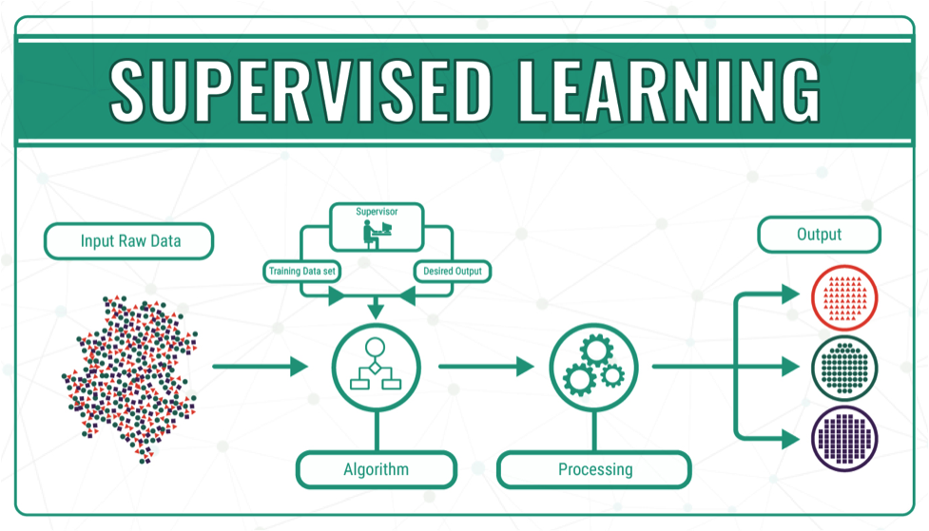
In this course, we are mostly going to focus on supervised learning, so lets look at supervised learning in detail.
Supervised Learning

Slide 12
Supervised learning, in the context of artificial intelligence (AI) and machine learning, is a type of system in which both input and desired output data are provided. Input and output data are labeled for classification to provide a learning basis for future data processing.
Classification: A classification classifier (model) is the type of model in which the output variable (i.e the Label) is Discrete. E.g To predict if the patient has cancer or not, if an employee will leave or stay e.t.c.
Type of Classification Model
Logistic Regression
Decision Trees
Random Forest

Slide 13
Regression: A Regression model is the type of model in which the output variable is continuous. E.g Predict price of a house in an area, how much rainfall will occur in an area e.t.c
Type of Regression Model
Linear Regression
Decision Trees Regression

Slide 14
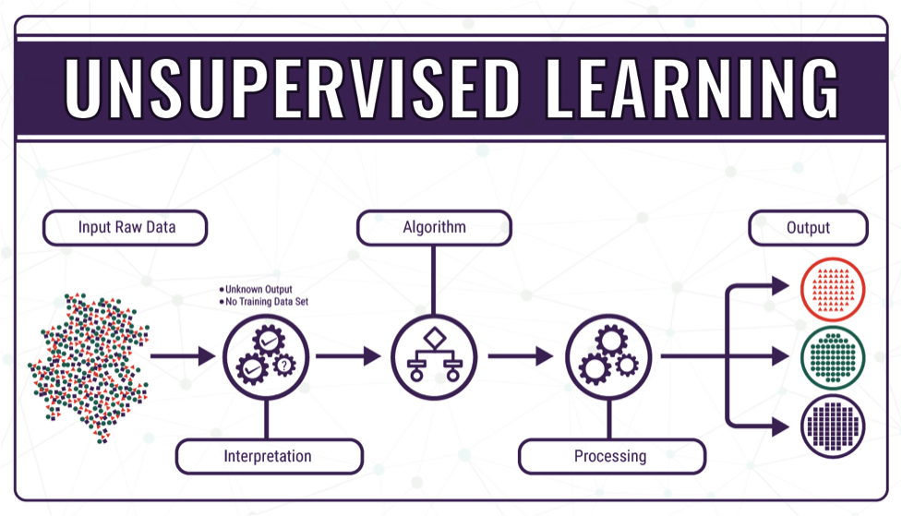
Unsupervised Learning
Unsupervised Learning is the type of learning in which the outcome variable (i.e the label is not available), what we are looking for in the dataset is the relationship between each datapoint.

Slide 15
Type of Unsupervised Learning Model
Clustering
Association.
Clustering : Clustering is an important concept when it comes to unsupervised learning. It mainly deals with finding a structure or pattern in a collection of uncategorized data.
Types of Clustering Models
Hierarchical clustering
K-means clustering
K-NN (k nearest neighbors)

Slide 16
Association: Association rules allow you to establish associations amongst data objects inside large databases. This unsupervised technique is about discovering interesting relationships between variables in large databases. For example, people that buy a new home most likely to buy new furniture.
Other Examples:
A subgroup of cancer patients grouped by their gene expression measurements, Groups of shopper based on their browsing and purchasing histories, Movie group by the rating given by movies viewers.

Slide 17
Now that we are all familiar with the concept of machine learning, lets now proceed to look at how we can build our own machine learning models using some of the algorithms.
Note: we won’t go deep in the explanations on this slides, however, we are going to cover a lot here, then later in class we discuss some of them in details.
We are going to start from the basics, and then build our way up.

Slide 18
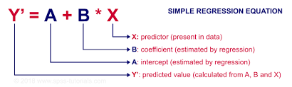
Simple Linear Regression
simple linear regression is a linear regression model with a single explanatory variable. In this example, we are going to use the salary dataset, we want to see the relationship between the year of experience of employees and their salary.
Hence, building a model that is capable of predicting the salary of any employee for all years of experience.

Slide 19
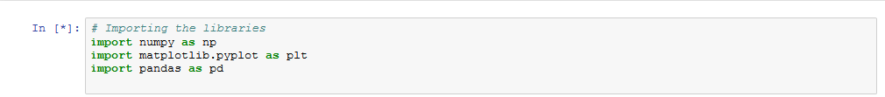
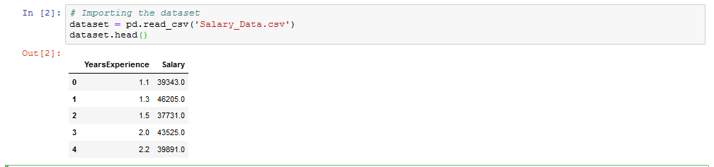
In your new notebook, start by importing the libraries needed for this analysis.
Thereafter, you import your dataset and view the first few rows;

Slide 20
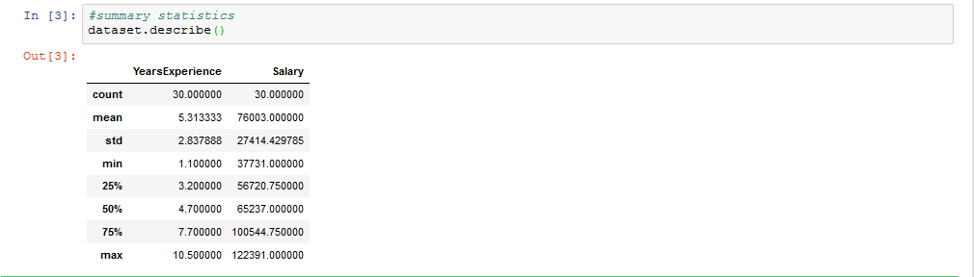
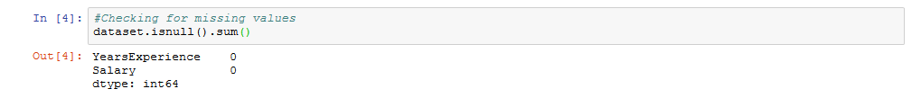
Take the summary statistics of your data;
Check for missing values;

Slide 21
Now, lets separate the data into the dependent and independent variable, we will call the dependent variable y, and call the independent variable X. then we will convert them into arrays using the ‘.values’ method.
Next, we split our data into training and test set, the training set is the data we use in building our model while the test is the one we use to see how good the model is, to do that, we are going to import the function ‘train_test_split’ from the function ‘model_selection’ in ‘sklearn’.

Slide 22
What we just did was simply to assign one third of the data to the training set and the rest to the test set.
The next thing we do was to fit in our linear regression model, to do that, we have to import the ‘LinearRegression’ function from the ‘linear_model’ in ‘sklearn’. Then we assign it to a variable name.
Now, lets fit our model and then make predictions.
Lets now put our predicted value together with our test data and make a plot.

Slide 23
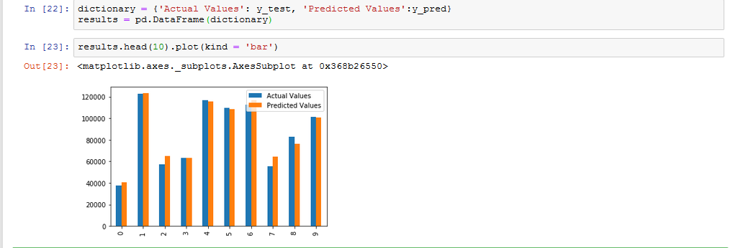
Looking at the plot, you can see that our model did a very good job in terms of predicting the salary of employees based on their year of experience.
We are going to continue by visualizing the training set results as well as the test set results.

Slide 24
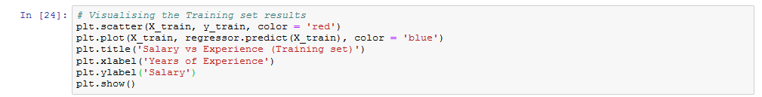
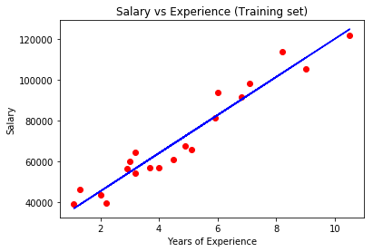

Slide 25
